Slide 1
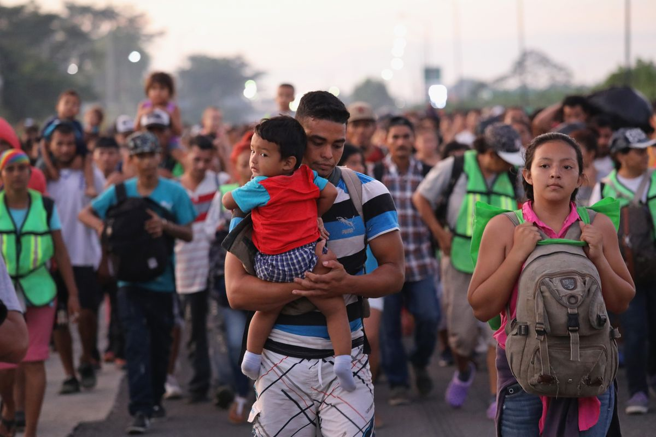
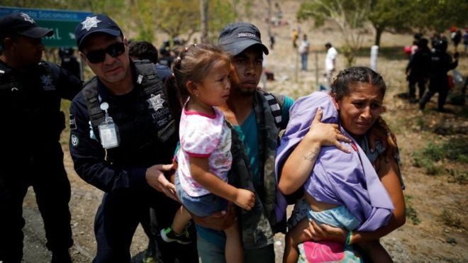
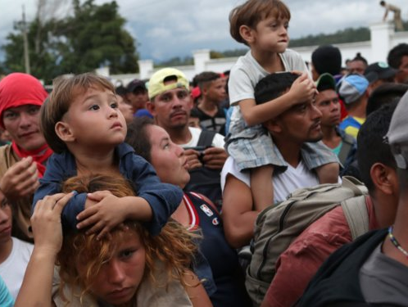

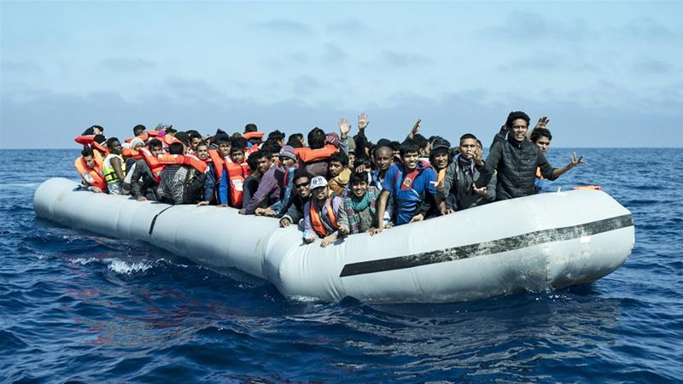
MISSING MIGRANTS
PYTHON PROJECT
Team 2
Shruti Gupta
Zaid Ahmed
Deeksha Goyal
Wenying Huan
Ruthvik Arepalle

Slide 2
FLOW OF PRESENTATION / AGENDA
Data Exploration
Topic’s Motivation
Dataset
Data Analysis
Q & A
1
2
3
4
5
Data Manipulation
Summary Statistics
Data Cleaning
Graphical Analysis
Grouping
Data visualization
Cross Tabulation
Clustering

Slide 3
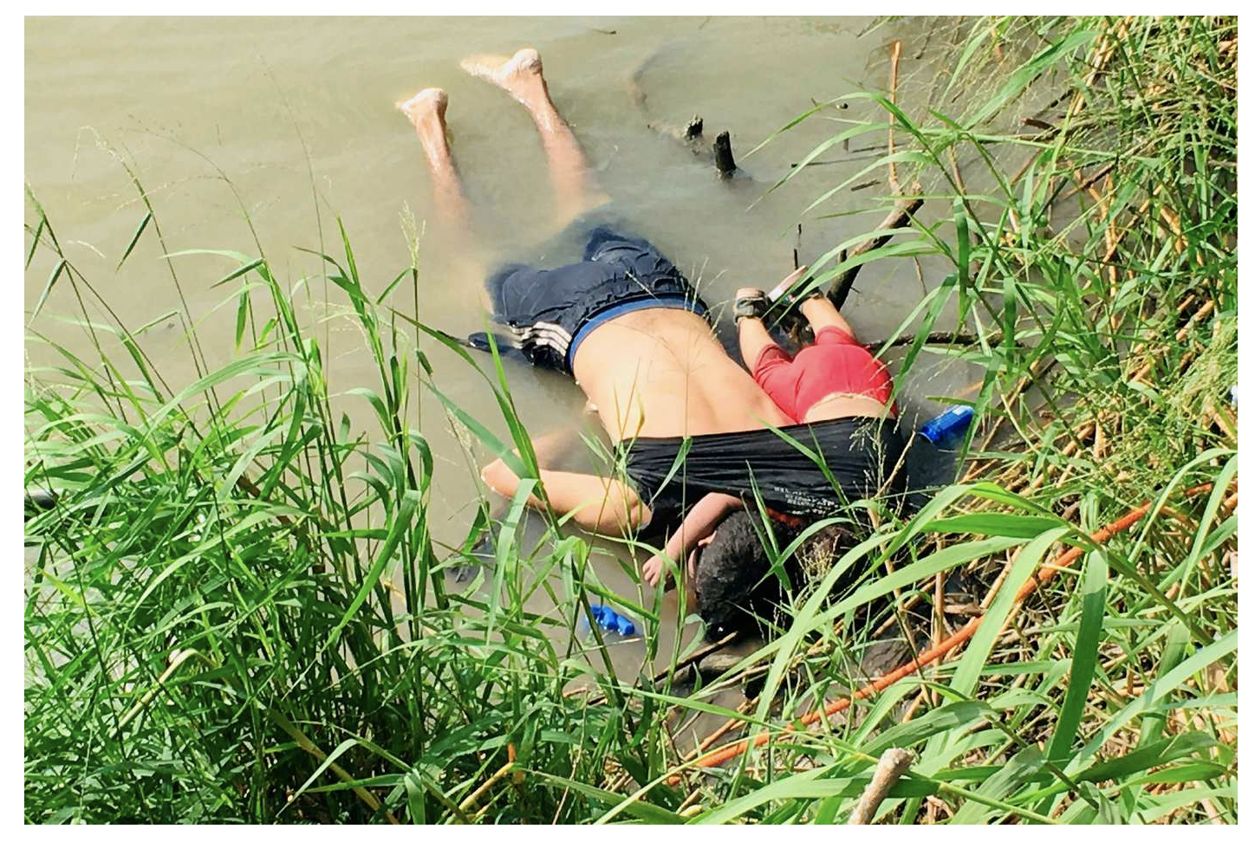
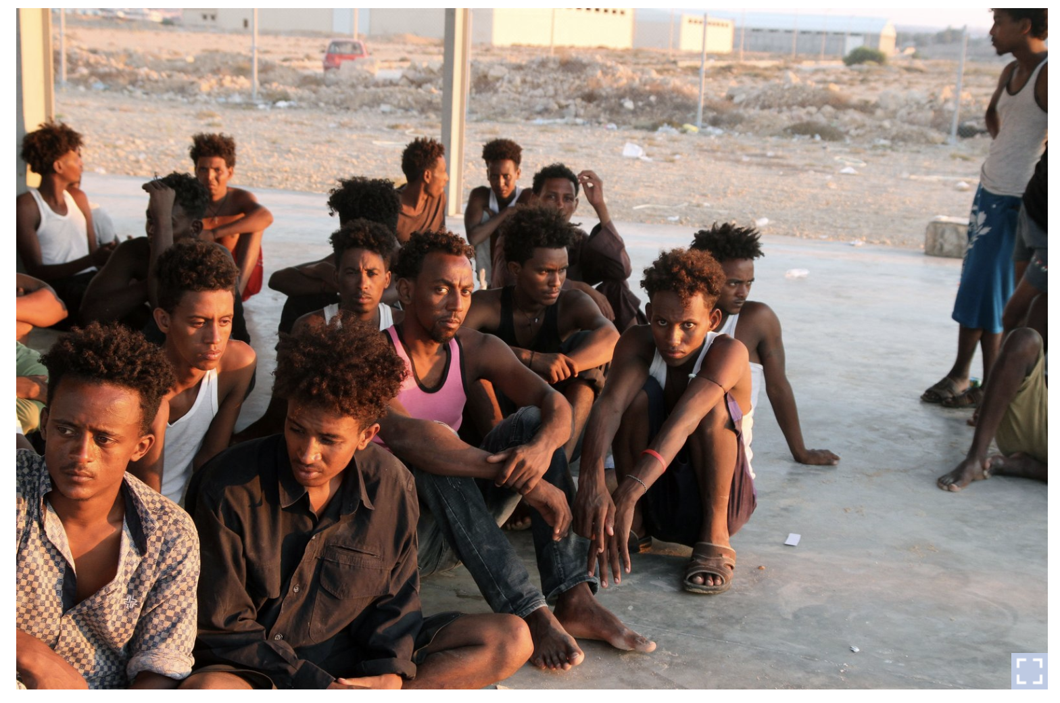
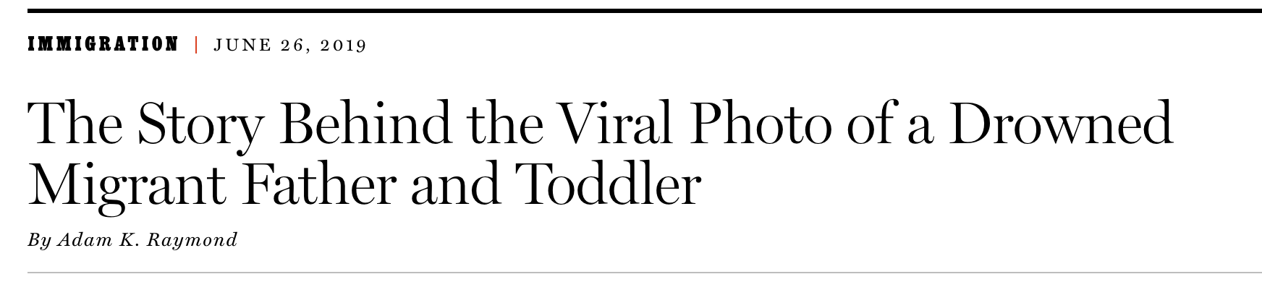
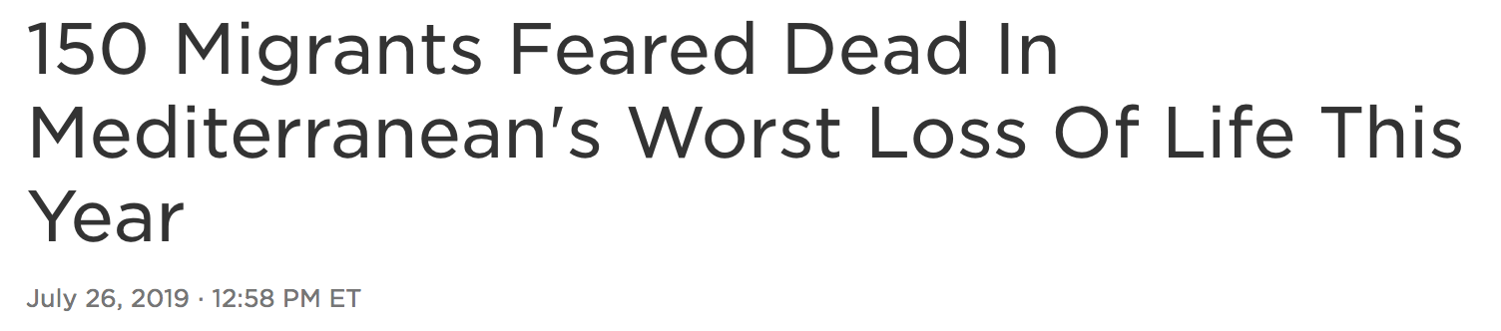
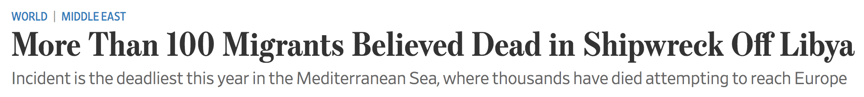
Global Problem

Slide 4
Motivation
Who are these migrants?
People who have died or gone missing en route to an international destination in the search of a better life for themselves and their families
Why does the data on missing migrants need our attention?
Understanding this global tragedy and designing practical protection measures are necessary to prevent further loss of life and end the horror of migrant deaths

Slide 5

Missing Migrants Project
Recorded since Jan 2014 to present
Used dataset from Jan 2014 to March 2019 from Kaggle
IOM's Missing Migrants Project tracks incidents involving migrants and those who have died or gone missing along migratory routes worldwide
Refugees and asylum-seekers included
Dataset - 20+ variables, 5580+ rows
IOM - International Organization for Migrant

Slide 6
Questions Addressed
How does the distribution of migrants disappearance vary geographically and yearly in time?
Which locations / areas are more prone to deaths and accidents to identify regions where asylum can be built there to reduce human loss?
What’s the demographic of migrations who died on the way in different regions.
What are the major factors and reasons of migrant deaths in different regions?

Slide 7
DATA DICTIONARY
Region of Incident
Reported Date
Reported Year
Reported Month
The region in which an incident took place
Estimated date of death
The year in which the incident occurred
The month in which the incident occurred
Number Dead
Number Missing
Total
Dead and Missing
Number of Survivors
Total number confirmed dead in one incident
Total number of missing thus assumed to be dead
Sum of “Number Dead” and “Number Missing”
Number of migrants that survived the incident
https://missingmigrants.iom.int/methodology

Slide 8
DATA DICTIONARY
Number of Females
Number of Males
Number of Children
Age
Number of females found dead or missing
Number of males found dead or missing
# of individuals under age 18 found dead / missing
The age of decedents (estimated age)
Country of Origin
Region of Origin
Cause of Death
Location Description
Country of birth of the decedent
Region of origin of the decedent
Determined conditions result in migrant's death
Place where the deaths occurred or where the body or bodies were found
Location Coordinates
Migration Route
UNSD Geographical Grouping
Source quality
Coordinates of where the deaths occurred or where the body or bodies were found
Migrant route name on which incident occurred
Geographical region where incident took place
Information reliability, ranked 1 - 5
https://missingmigrants.iom.int/methodology
Notes:
© Copyright Showeet.com – Free PowerPoint Templates

Slide 9
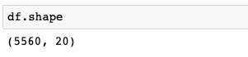
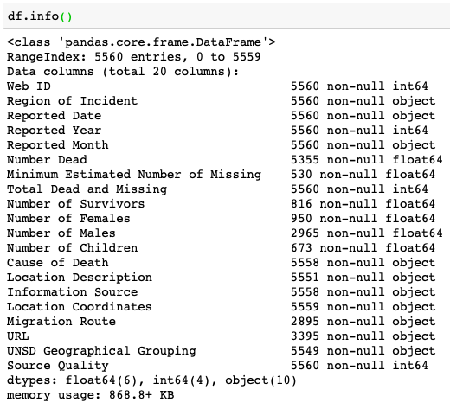
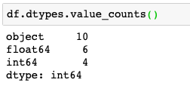
Data Description
CHECKING NUMBER OF ROWS AND COLUMNS
INFORMATION OF ALL THE VARIABLES
DATA TYPES AND THEIR RESPECTIVE COUNTS

Slide 10
Data Exploration
1
Data Manipulation
2
Summary Statistics
3
Data Cleaning
4
Graphical Analysis

Notes:
© Copyright Showeet.com – Free PowerPoint Templates

Slide 11
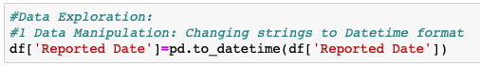
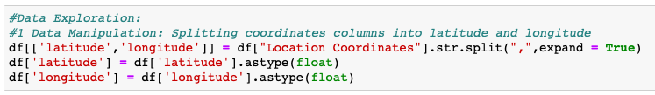
Step 1 - Data Manipulation
Step-1: Used ‘to_datetime’ in pandas to change Reported date column from strings to a date time format
Step-2: Split Location Coordinates column into two columns i.e. Latitude & Longitude using ‘.split ’.
Step-3: Lastly, used ‘drop()’ function to delete the columns not required for analysis

Slide 12
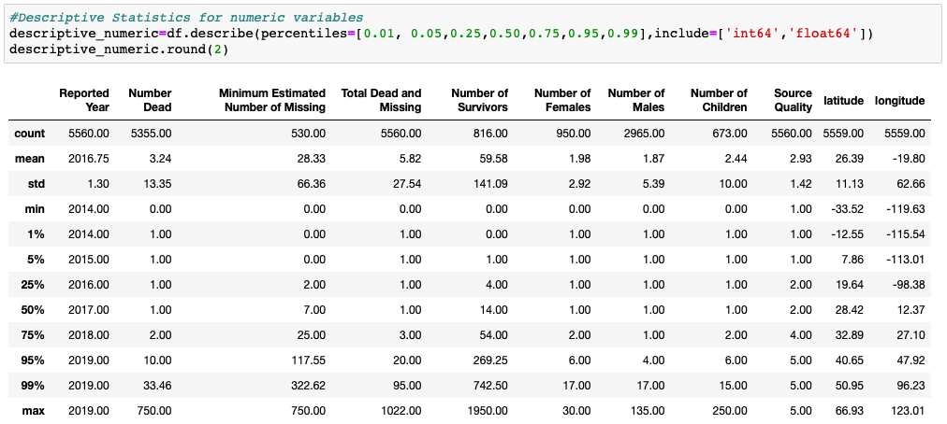
Step 2 - Summary Statistics
Describe method: To understand the numeric data, included int and float data types
Five Point Summary
Minimum
First Quartile
Median
Third Quartile
Maximum

Slide 13
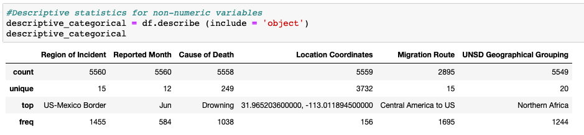
Step 2 - Summary Statistics
Included ‘object’ data type to understand the categorical data.

Slide 14
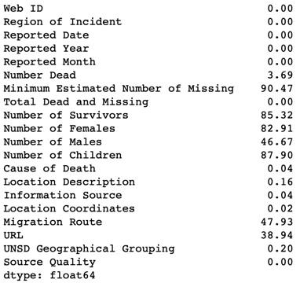
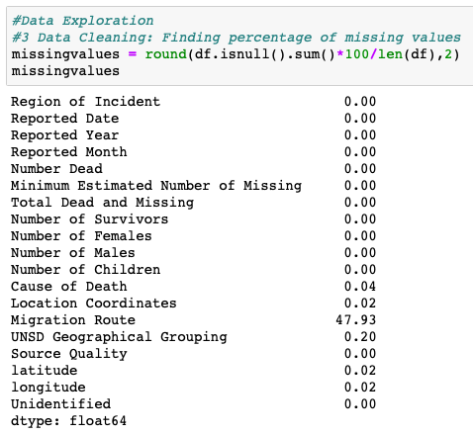
Step 3 - Data Cleaning
Issues: A lot of missing values in key columns, many categories of data which was difficult to study and analyze
BEFORE vs AFTER

Slide 15
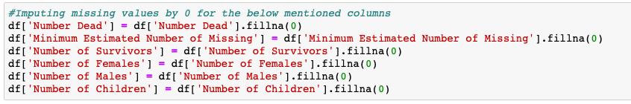
Step 3 - Data Cleaning
Issue: In few of our columns we had decent share of missing data.
Steps: We used ‘.fillna(0)’ to replace missing cells with 0.

Slide 16
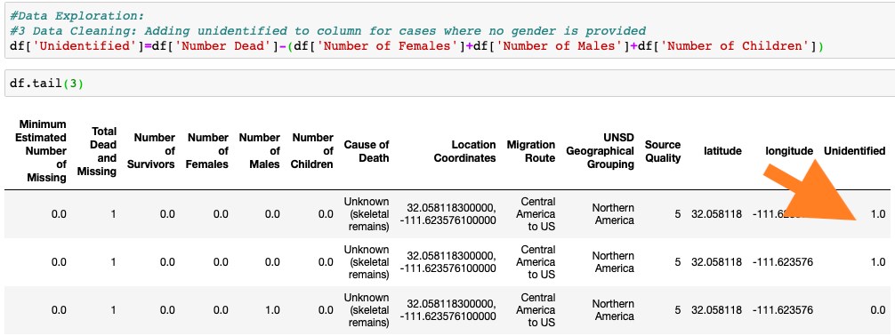
Step 3 - Data Cleaning
Issue: In few of the cases among column ‘Number of dead’ there were no gender or age category associated with it
Steps: Added a new column category ‘unidentified’ to correct it

Slide 17
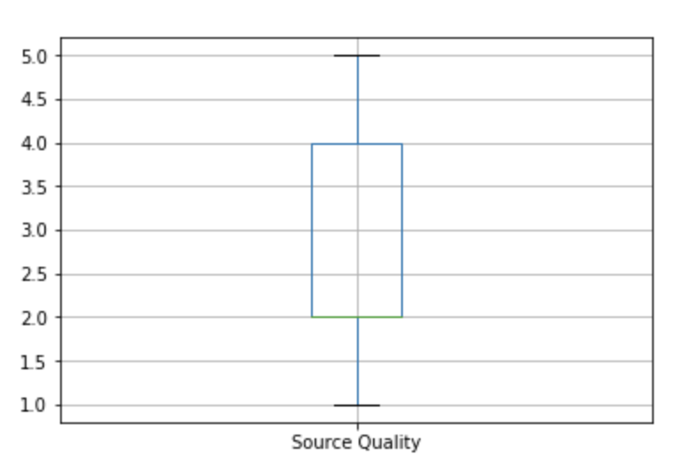
Step 4 - Graphical Analysis
Challenge: Lacks a systematic way to report data, comes from disparate sources in different formats like News Articles (Reuters, BBC, CNN), Govt. Agencies, Social Media, Unverified sources etc.
To study reliability of data, used a box plot:
Any data with rating 3 and above is reliable
50% of data is reliable with source quality
rating 3, 4 and 5
25% of data comes from highly reliable sources

Slide 18
Data Analysis
1
Grouping Multiple Categories in variables
2
Graphical Representation & Insights
3
Cross Tabulation
4
Clustering

Notes:
© Copyright Showeet.com – Free PowerPoint Templates

Slide 19
Step 1 - Grouping Multiple Categories of Data
Issue: Multiple types of low frequency causes of deaths, which were generally caused by the same reason
Examples: Categories like ‘shot’, ‘stabbed’ and murdered’ are quite similar in terms of the causes or intention of the culprit
Steps: For instance,
Grouped ‘Shot’, ‘Stabbed’ and ‘Murdered’ as one category, that is, “Killed”
Grouped ‘Fall from’, ‘Fell’, ‘Falling’, etc into ‘Accident’
Grouped ‘Drowning’, ‘Presumed Drowning’ into ‘Drowning’
Steps: Grouped the missing value under this category as ‘Others’

Slide 20
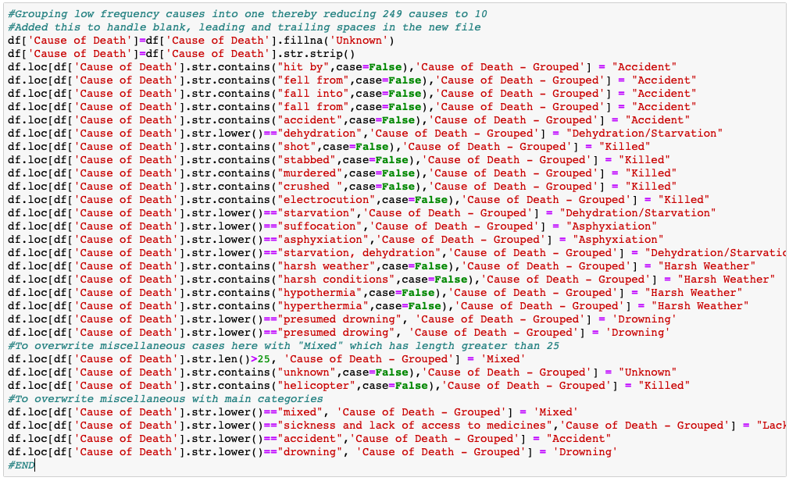
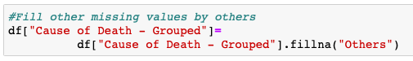
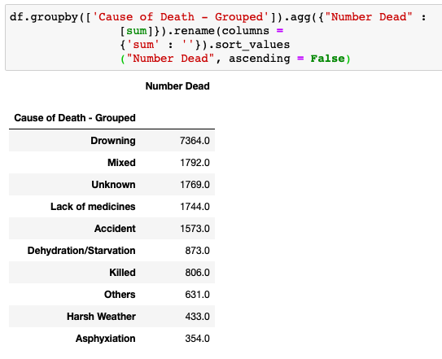
Step 1 - Grouping Multiple Categories of Data
Issue: 249 different causes of death -> Difficult to process and analyze
Step: Grouped 249 causes of death into 10 categories

Slide 21
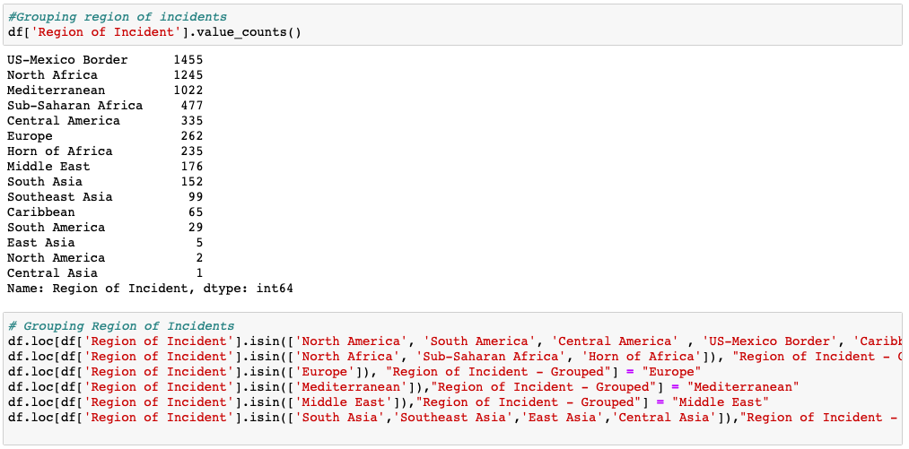
Step 1 - Grouping Multiple Categories of Data
Issue: Entries under column Region of Incident where migrants belonged to one main region but, were subdivided into multiple regions
Steps: Grouped such Region on incidents under a common group.

Slide 22
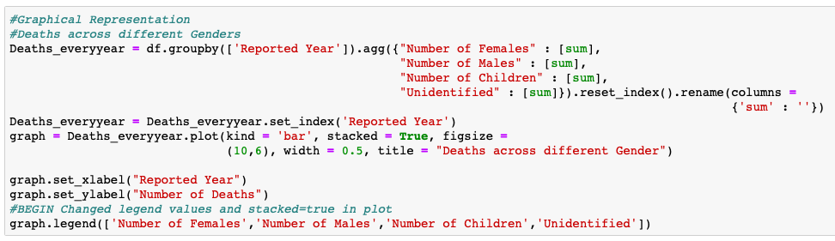
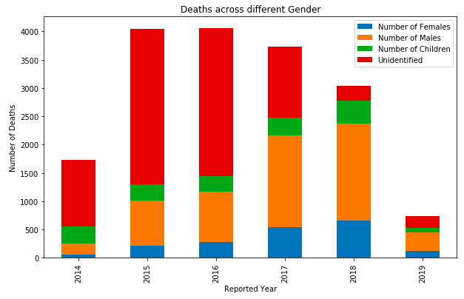
Step 2 - Graphical Representation & Insights
Data Collection is gradually becoming more accurate as number of ‘unidentified’ deaths are reducing over the years possibly because of increasing investment in this area to track the migrants and extensive use of technology and science

Slide 23
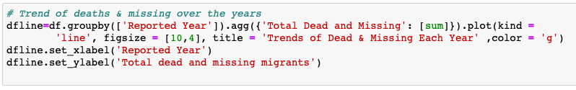
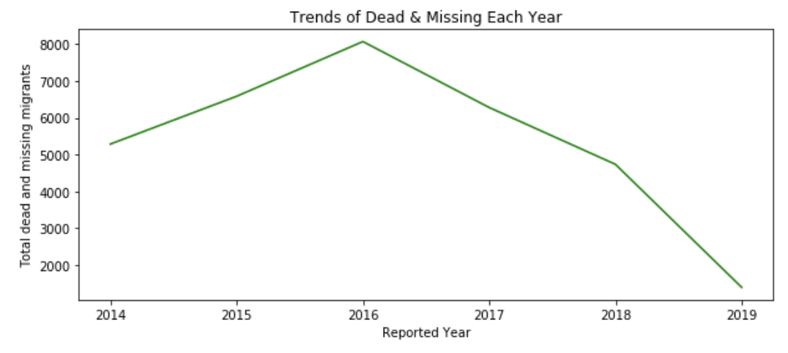
Step 2 - Graphical Representation & Insights
The death toll of immigrants was highest in 2016
This could possibly be because of the increase in attacks in Mediterranean region (Syria) during that time

Slide 24
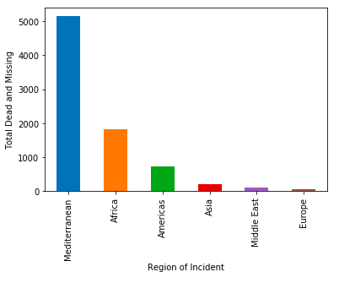
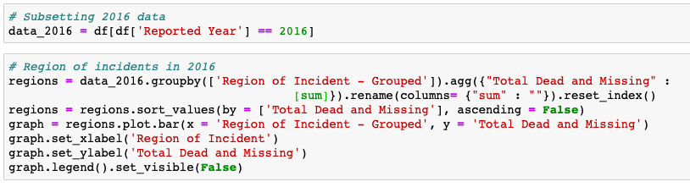
Step 2 - Graphical Representation & Insights
The data also depicts the trend that the death toll of immigrants for 2016 was highest in the Mediterranean region.

Slide 25
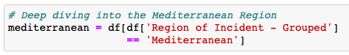
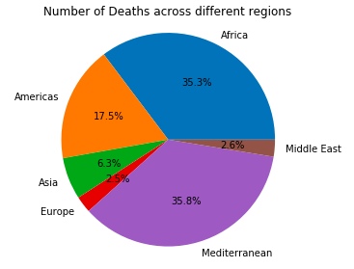
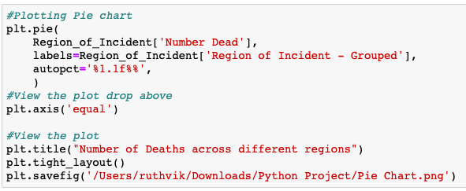
Step 2 - Graphical Representation & Insights
If we consider all the years of recorded data, even in that case the deaths at Mediterranean has the highest share.
Hence, we have focused on Mediterranean region for our study and done a deep analysis for that region.

Slide 26
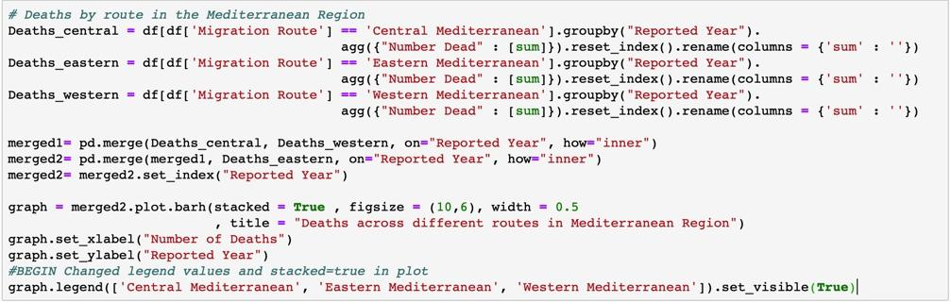
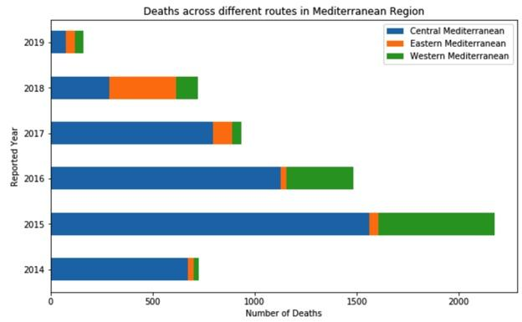
Step 2 - Graphical Representation & Insights
Here, the data suggests that among the routes in Mediterranean, the deaths recorded in the central Mediterranean routes were highest
This trend has been consistent over the years

Slide 27
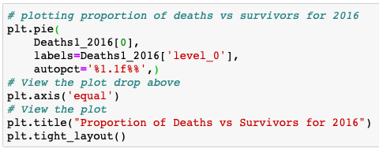
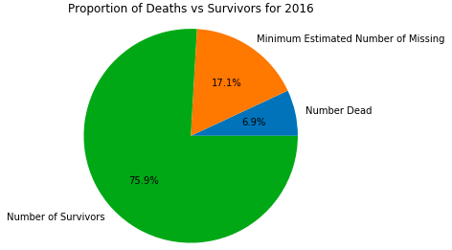
Step 2 - Graphical Representation & Insights
More than 5,000 deaths were recorded in the Mediterranean in 2016 alone
Increase in deaths is consistent across almost all regions of the world, most pronounced in the Mediterranean Sea

Slide 28
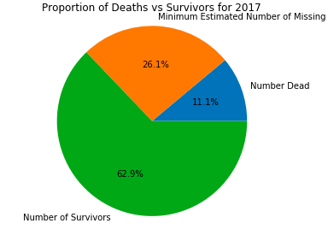
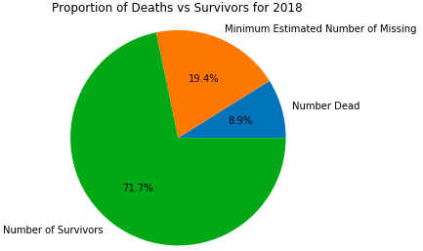
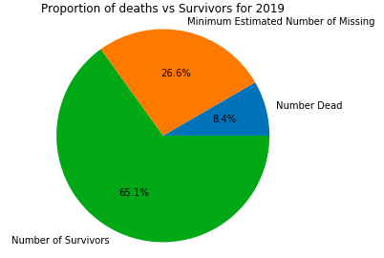
Step 2 - Graphical Representation & Insights
The proportion of migrant deaths in the Mediterranean region has increased significantly over the past 4 years – an 11 per cent increase from 2016 to 2019

Slide 29
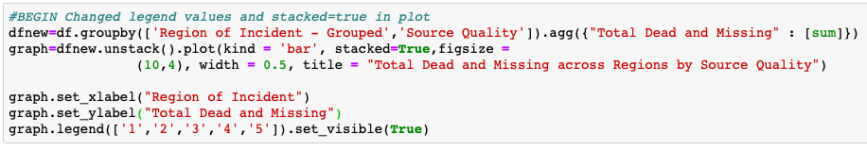
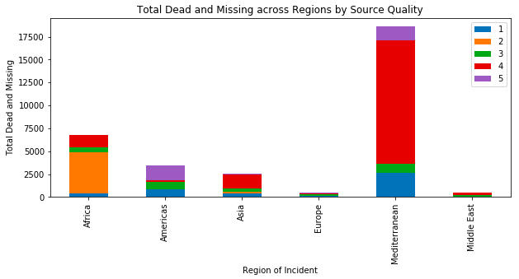
Step 2 - Graphical Representation & Insights
The quality of data obtained from Mediterranean is the most reliable and can be used to make suggestion for solving the migration crisis.
The data from Africa is not reliable and needs to be checked before driving further analysis.

Slide 30
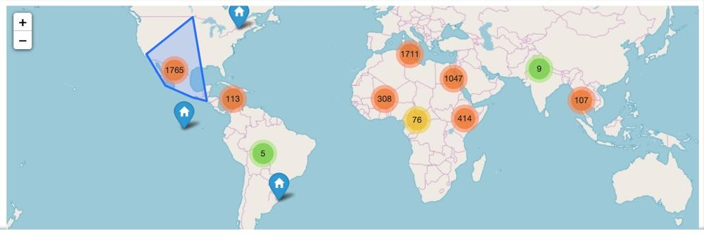
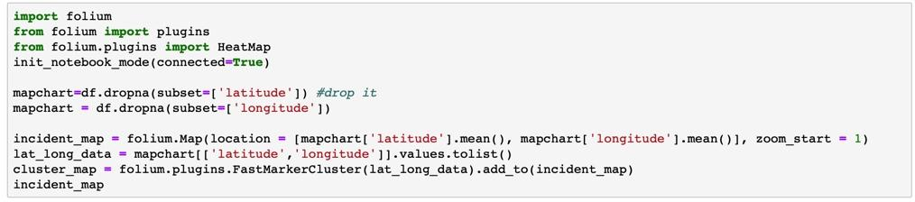
Step 2 - Graphical Representation & Insights

Slide 31
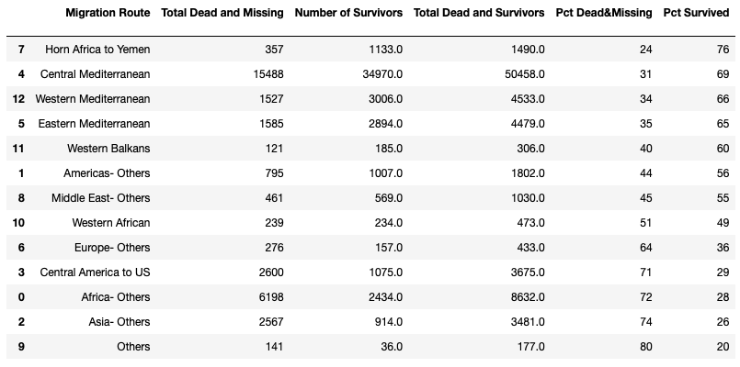
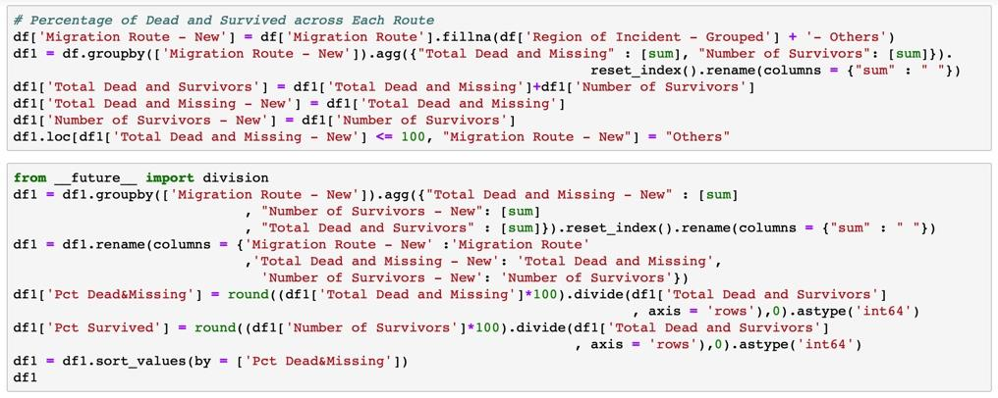
Step 3 - Cross Tabulation

Slide 32
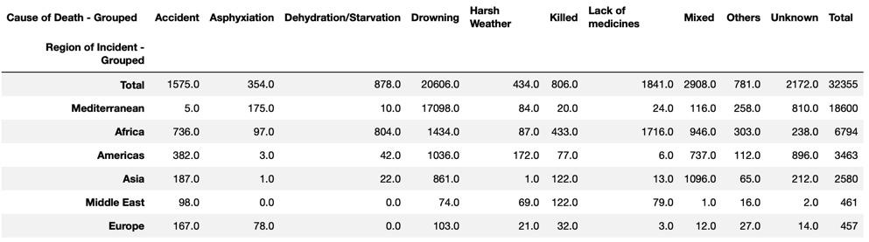
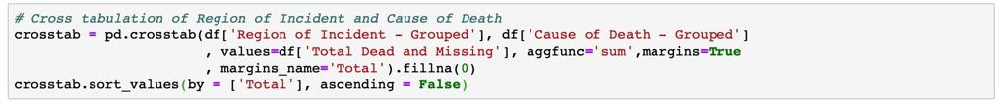
Step 3 - Cross Tabulation

Slide 33
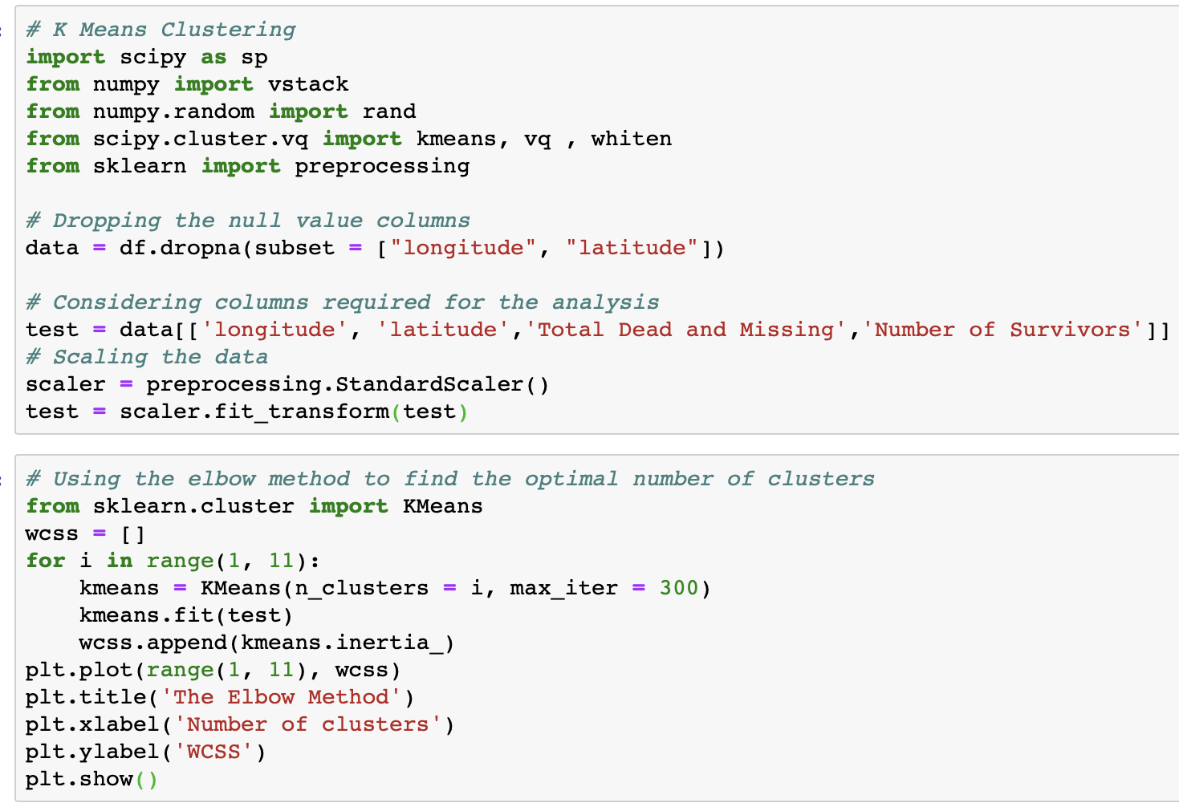

Step 4 - Clustering

Slide 34



Step 4 - Clustering

Slide 35
Summary &
Recommendations
Regions in Mediterranean and Africa are more prone to the deaths of migrants, with a continuous high number of dead and missing migrants throughout last 5 years.
Drowning and lacking medicines are most common causes of dead.
Cooperation's of IOM & local governments is required to solve this problem.
Border control, Healthcare plan & sanitation.
Security

Notes:
© Copyright Showeet.com – Free PowerPoint Templates

Slide 36
Future Actions
The concerned authorities should improve data collection methods and should avoid missing data of demographics.
Drowning and lacking medicines are most common causes of dead.
Extend the project to ensure the followings:
Observe association between missing migrants and motives of migration.
Observe migrants’ characteristics, living condition and associate these data to study cause of missing/dead.
Observe changes in migration routes.
Prevention and protection plan

Notes:
© Copyright Showeet.com – Free PowerPoint Templates

Slide 37

Thank you!
QUESTIONS
&
COMMENTS?

Slide 38
BIBLIOGRAPHY
https://missingmigrants.iom.int/methodology
https://www.kaggle.com/snocco/missing-migrants-project

